Slide 1
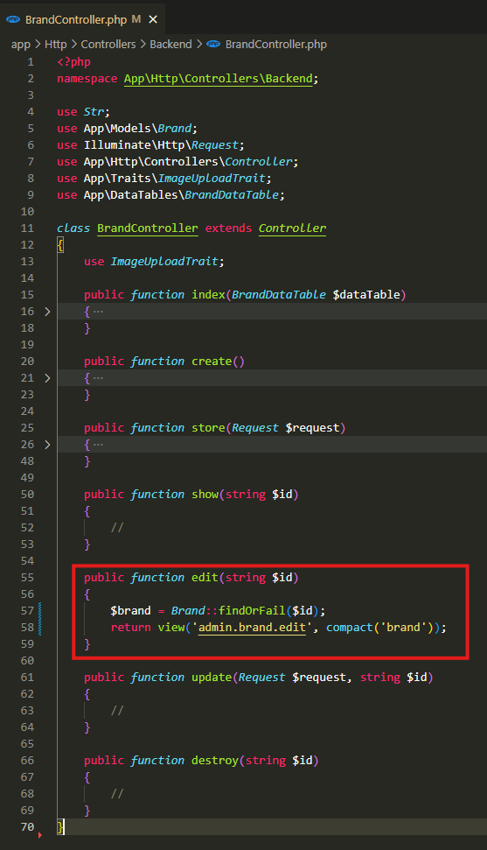
app\Http\Controllers\Backend\BrandController.php

Slide 2
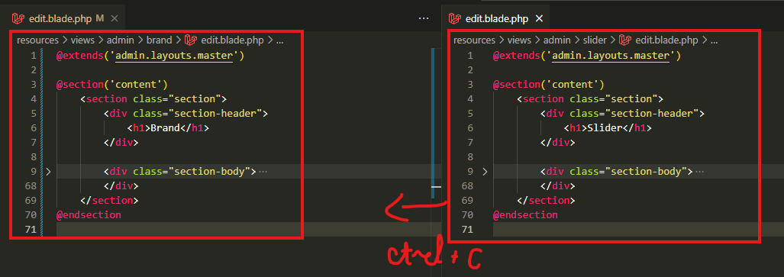
resources\views\admin\brand\edit.blade.php

Slide 3
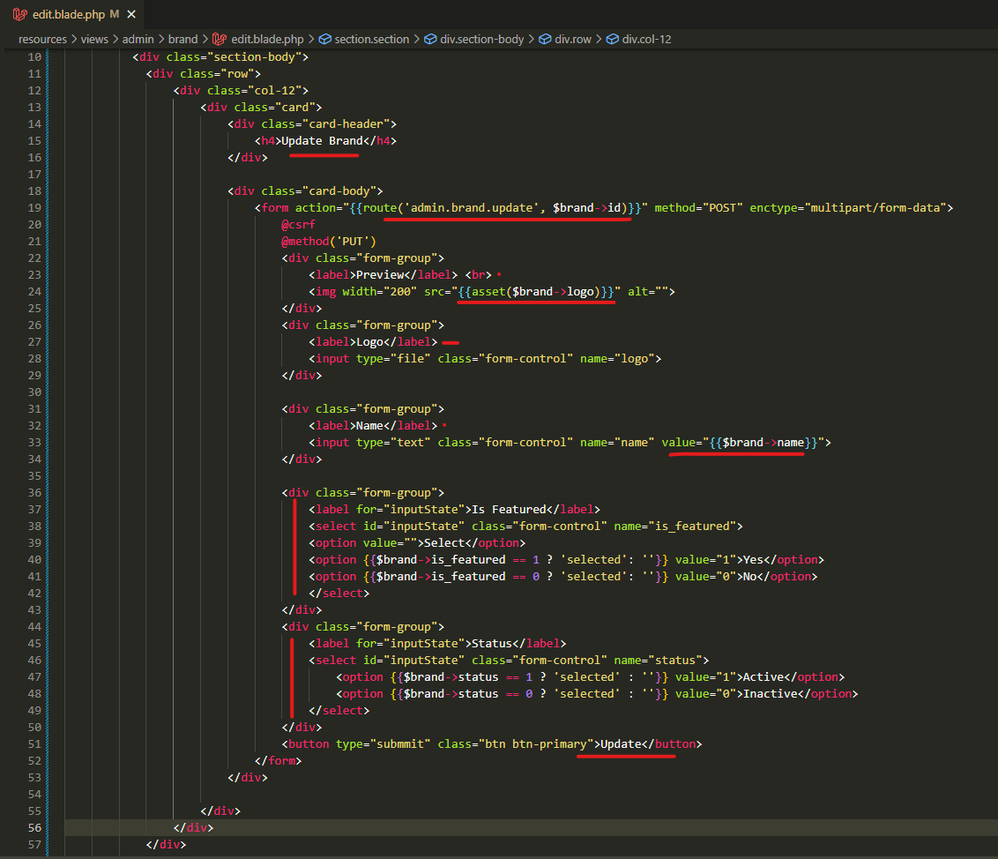
resources\views\admin\brand\edit.blade.php

Slide 4
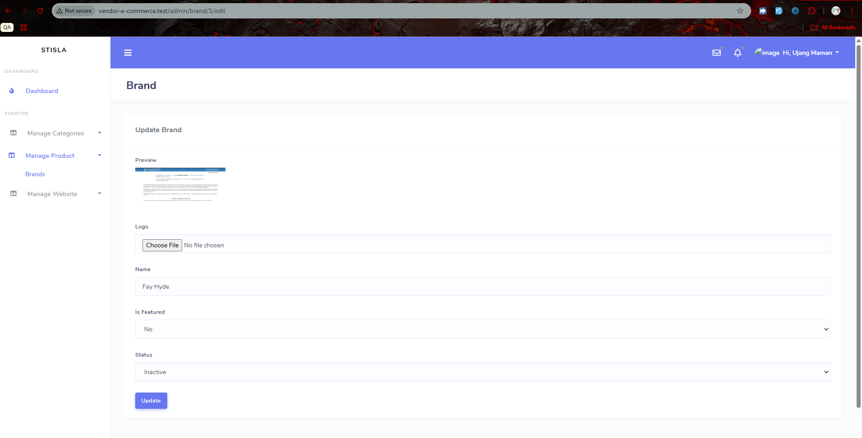
Edit page

Slide 5
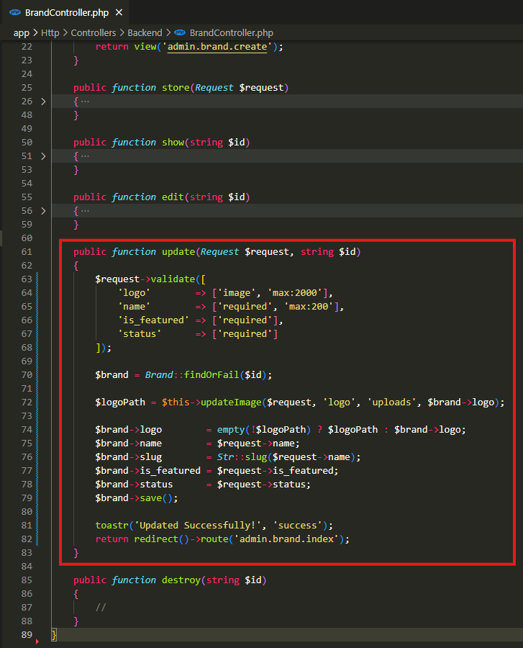
app\Http\Controllers\Backend\BrandController.php

Slide 6
.

Slide 7
.

Slide 8
.

